Slide 1
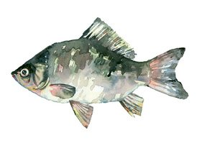
Inspiring, empowering, and transforming children's
lives through outdoor education.
Notes:
Hello Classroom Teachers! I typed out what I usually say in presentations. You do not need to say it how I typed it at all, these things just cover the bases well. If you forget things, the kids will just ask you about it at the end!
----------------------------------------------------------------------------------------------
Hi! This presentation is to let you know all about your upcoming super exciting and very adventurous educational 3-day 2-night field trip to Exploring New Horizons. We have been teaching students like you environmental education for over 40 years.

Slide 2
The Outdoor School Journey
starts at your school!
Make sure you’ve got everything you need for the
WHOLE WEEK!
Notes:
Exploring New Horizons has 2 sites. You will be visiting the Pigeon Point site which is located at the Pigeon Point Lighthouse. We will be doing all kinds of fun things while you are at Pigeon Point, such as tidepooling, going on nature hikes, and watching and observing wild life such as whales, elephant seals, and dolphins.

Slide 3
Where are we going?
Pigeon Point Lighthouse,
Pescadero, CA
Notes:
The Pigeon Point Lighthouse is a California State Park that is located on the beautiful Pacific Coast Hwy 1 in the town of Pescadero. Pescadero is located about 30 miles north of Santa Cruz and 50 miles south of San Francisco.

Slide 4
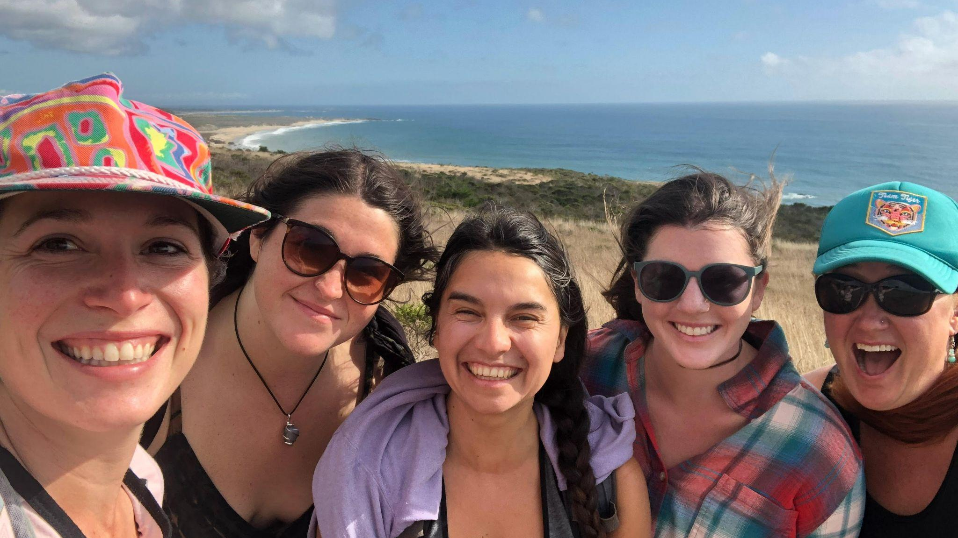
WELCOME!
We’re all here to help, just ask!
Notes:
When you first arrive, you will meet your Exploring New Horizons naturalists! They are all college graduates who have studied a wide range of things. They are called naturalists because they study nature. They’re your instructors for the week, taking you on hikes and leading all of the activities. Your classroom teacher and parent chaperones will be there so you will have familiar faces to help you out as well.

Slide 5
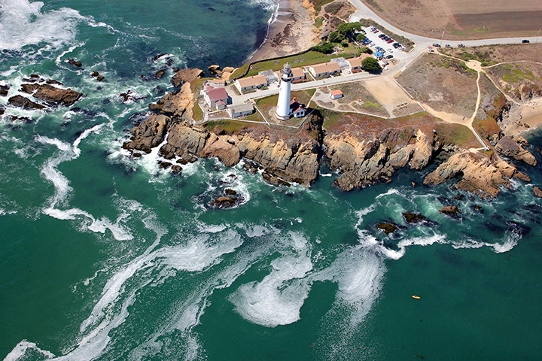
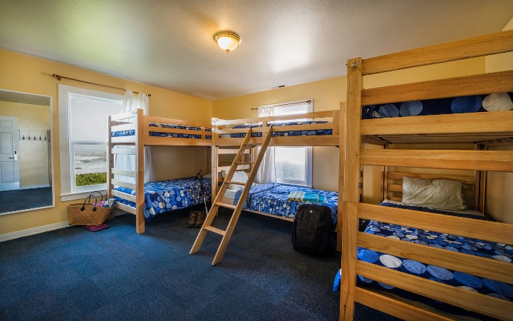
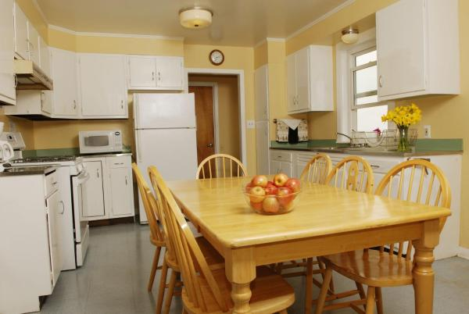
Notes:
Let’s talk about life at the Pigeon Point lighthouse! This will be your home away from home for the time that you spend with us. You can see some of the dorms that you will be staying in here. You will have the coolest neighbors during your time at Outdoor School. Your neighbors will be the historic Pigeon Point Lighthouse, the Pacific Ocean, and of course, your classmates! Your teacher will let you know more about the how many dorms your class will be using when you visit. Girls and boys will have separate rooms and bathrooms. Parent chaperones will be in every dorm.

Slide 6
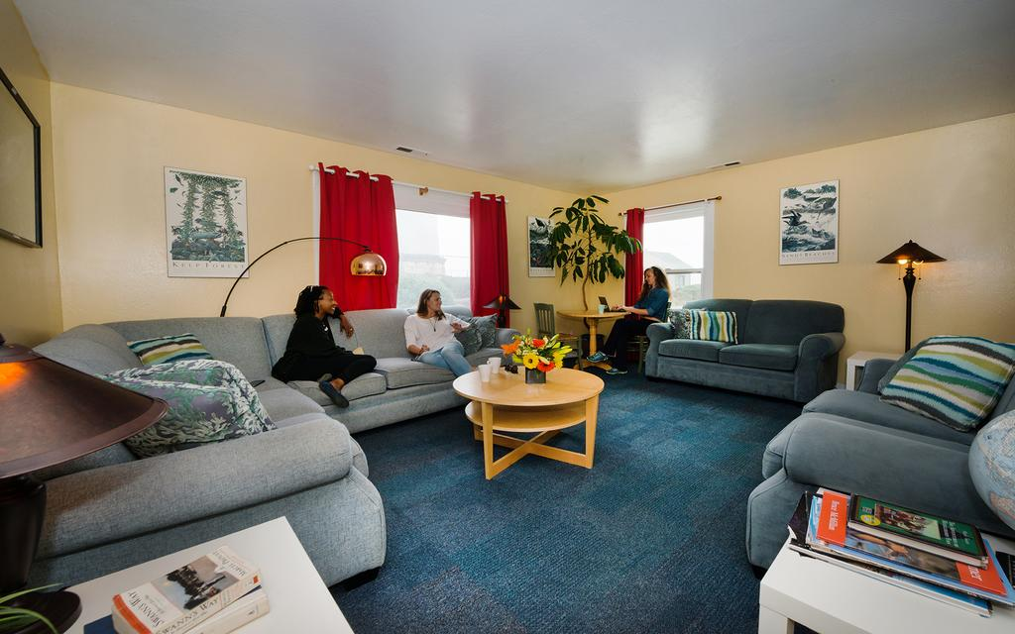
Dorms!
Notes:
Now let’s talk about moving into your dorms! When it is time for move in, we will give you a little time to take a tour of the dorm and then we will have a move-in meeting. During the move in meeting, we will talk about rules in the dorms and at Outdoor School, and how to successfully share the dorms with up to 14 people. We will also talk about what to do in the case of an emergency, the daily schedule and all of the important stuff that you need to know to stay safe and have a great time at Pigeon Point.
After our move in meeting you will get to move into your dorm room! There are 3 rooms in each dorm, one will be for a teacher, naturalist, or an adult chaperone. The two other rooms are for the students and chaperones and they have 6 beds each. The beds have very comfortable memory foam mattresses and the rooms are heated. There is a bathroom right next to the both of the bedrooms. They are single occupant bathrooms with a flushing toilet, hot and cold running water, and a locking door for privacy.
Each dorm has a living room, 3 bedrooms, and 2 bathrooms and a kitchen.

Slide 7
Kitchen
Notes:
The kitchens are where the food is prepared. We have some very special people that are in charge of making the meals at Pigeon Point
YOU get to cook! At Pigeon Point the students get to help with all aspects of food preparation! Our naturalists will give you all training to help out with preparing the meals. You will be in chore groups on a rotating schedule to help prepare the meals
And students also help set the tables and bring the food to the galley
And then when the meals are ready we all sit together in our common dining space, the galley. When the food is served you can be proud that you and your classmates came together as a team to make the delicious meals that we share. We eat breakfast and dinners in the galley, lunches are picnic style and we have them on the trail. Your teacher will give you a menu that will let you know about all of the meals that we will have when you are at Pigeon Point. Please note that we are peanut and tree nut free and if you have any food allergies we will make sure that the menu is right for you.
In addition to helping prepare the meals and set the tables, you will be helping out with cleaning up after the meals. This includes sweeping, wiping the tables, and drying the dishes. Speaking of cleaning up, everyone will come together before you move out to clean the dorms so you can leave them just as clean as when you moved in. We have will have a cleaning party! We make chores fun at Pigeon Point!

Slide 8
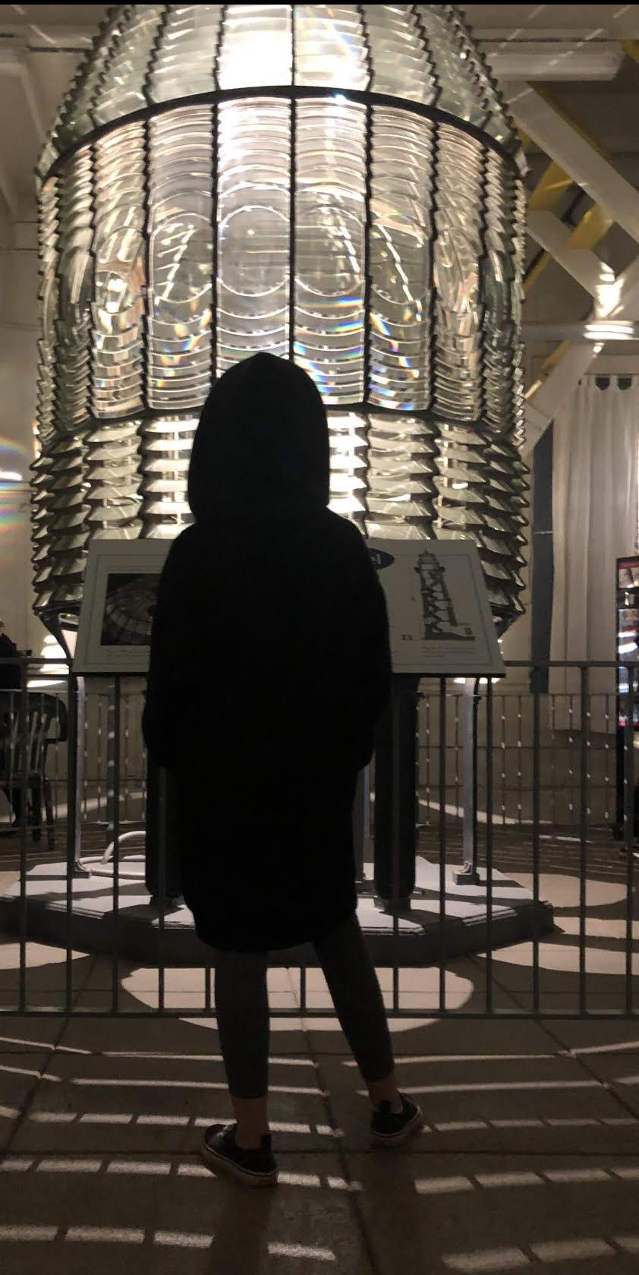
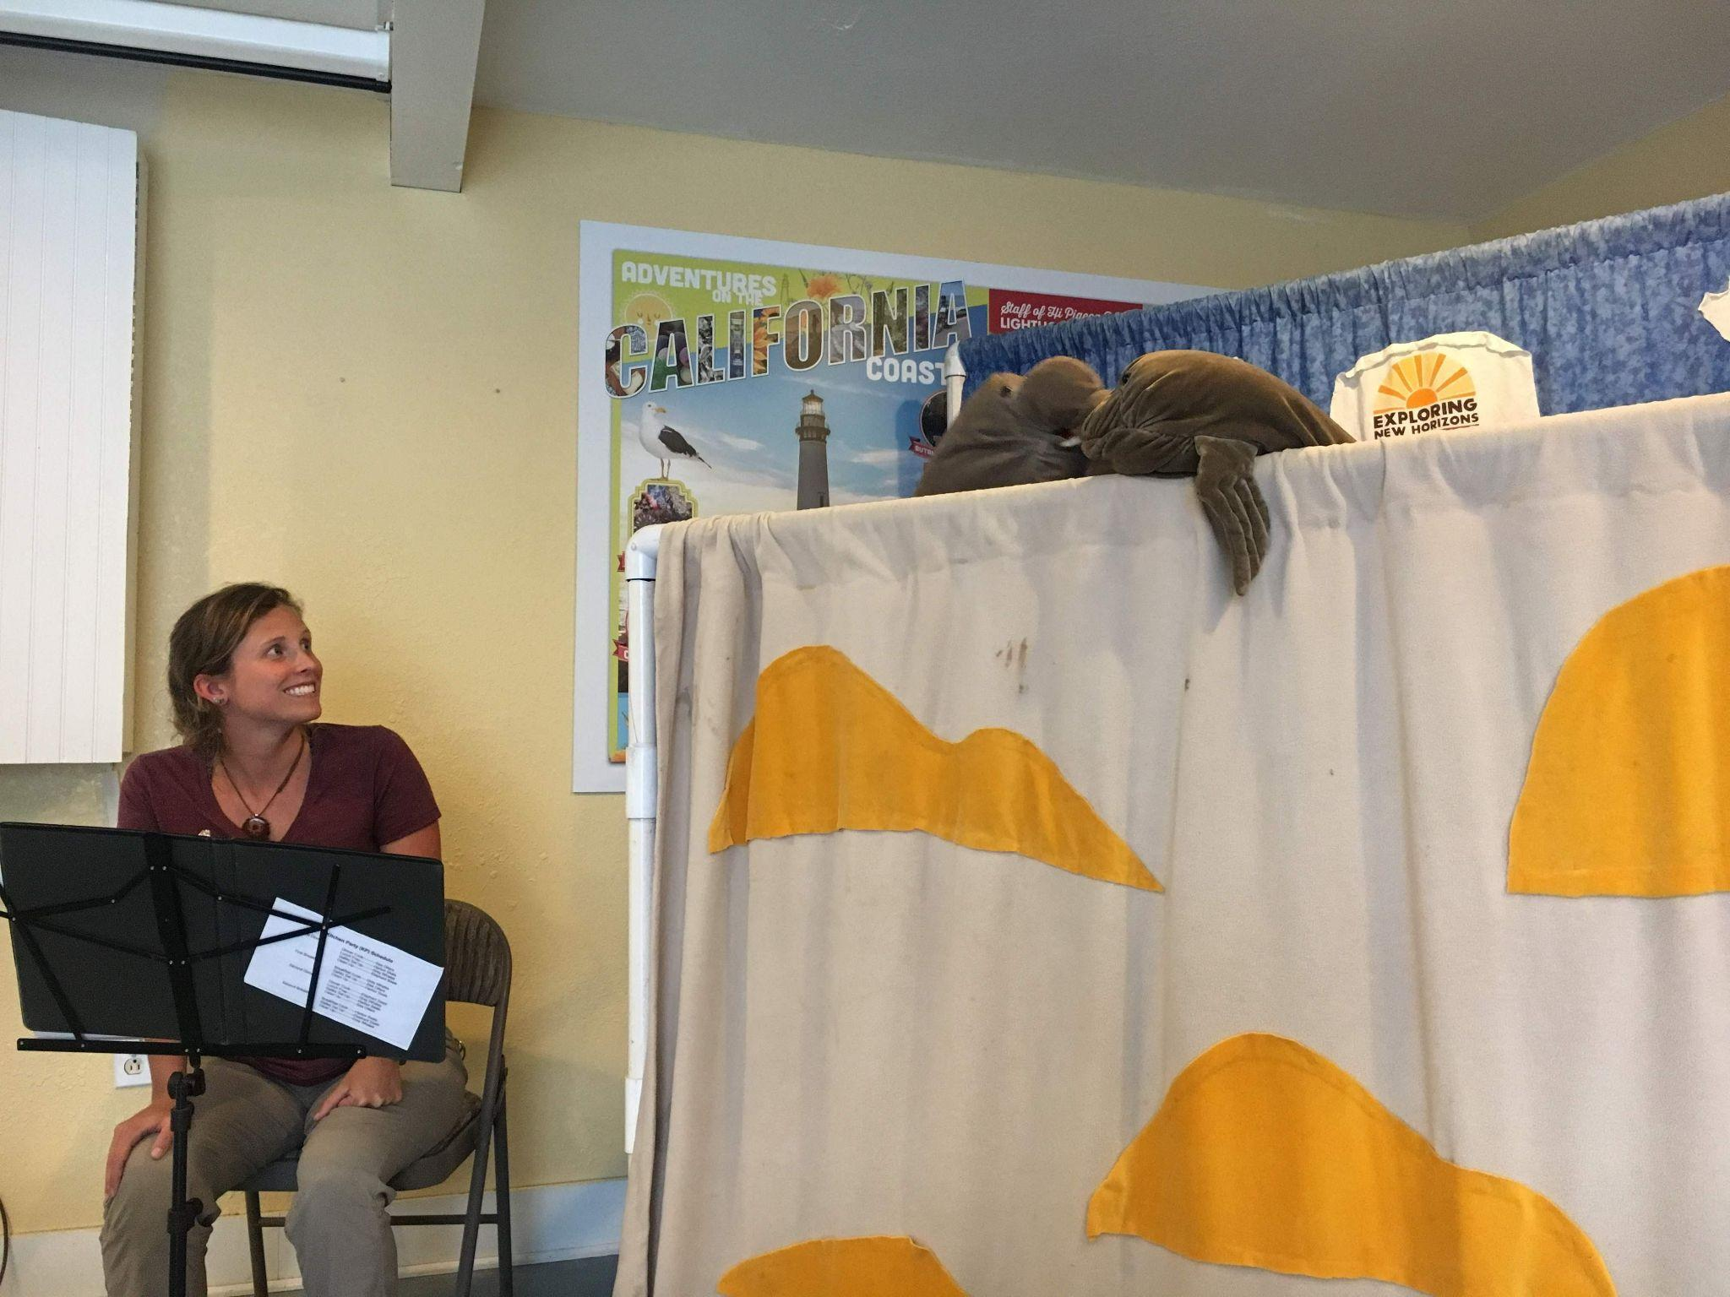
★Evening Activities★
Notes:
After dinner and clean up we come together for some evening activities. Each class might do something a little different. Evening activities might include a puppet show, story time, exploring our on-site historic museum, taking an evening hike, and watching the sunset from our ocean view deck called the Point.

Slide 9
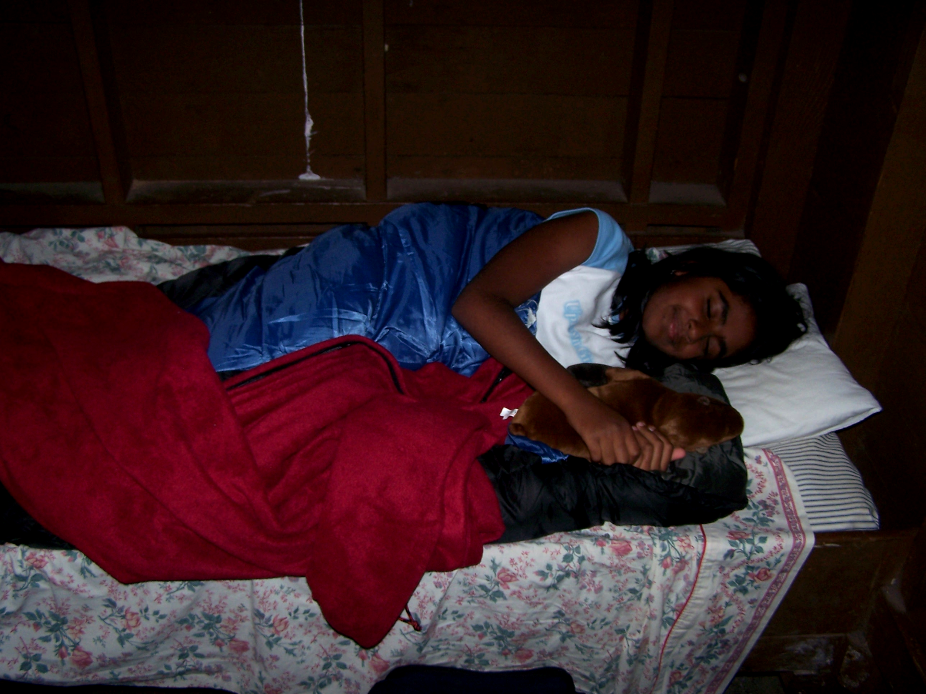
Lights Out at 9:30
Z
Z
Z
Z
Sweet Dreams!
Notes:
And then it is time for bed. You will get to see the light of Pigeon Point shining bright before you tuck in. You will have enough time to wash your face, brush your teeth and change into your pajamas before going to bed. You will bring your own blankets or sleeping bag to keep you cozy at night. Lights out is typically at 9:30 unless your teacher tells you otherwise, some groups go to bed earlier. After lights out, all students are expected to be quiet in their beds. We stay very busy during your time so you will be ready for a good nights sleep. You need to get plenty of rest for all of the adventures ahead!

Slide 10
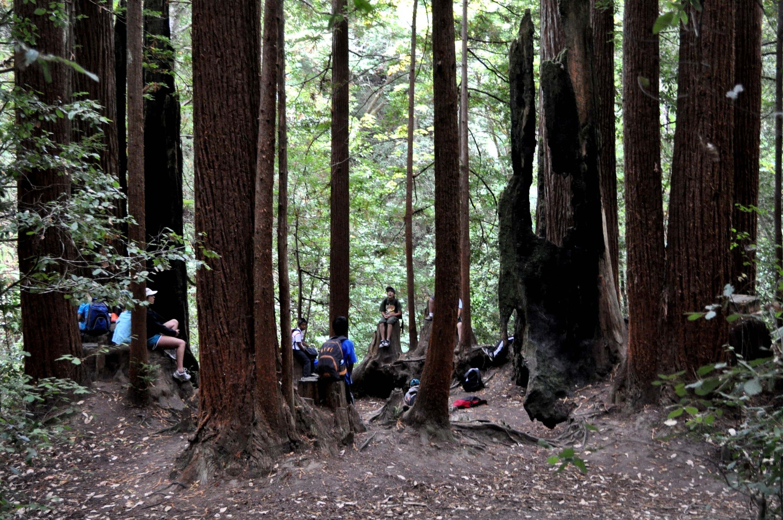
Our outdoor classrooms…
Notes:
Now let’s talk about some of our outdoor classrooms where we will be hiking, learning and exploring! Your teacher will give you a detailed schedule of what days we will be doing each activity. Every program has a slightly different schedule as it is created especially for your class!

Slide 11
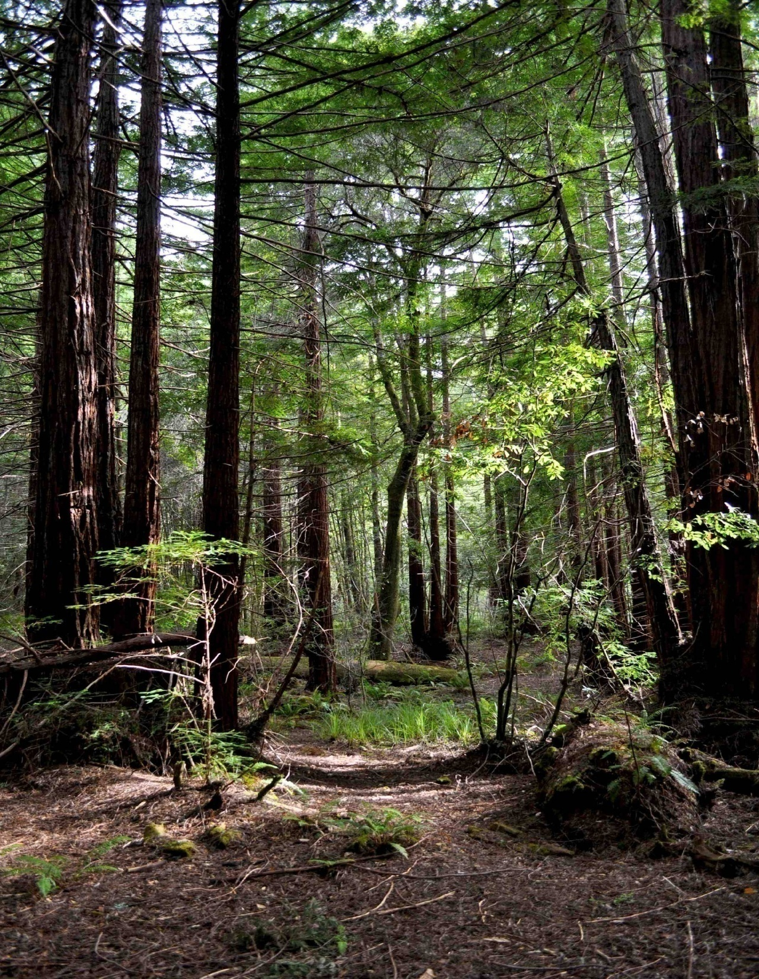
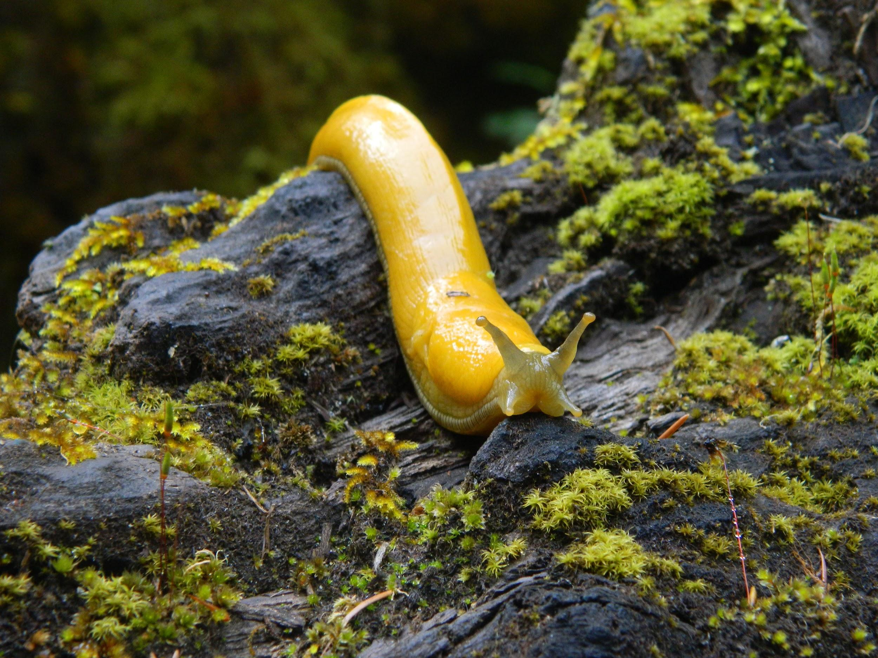
The Redwood Forest
Notes:
One of our amazing outdoor classrooms is the redwood forest! We go to Memorial County Park which is home to some really big and beautiful old growth redwoods.
Here we will be learning about the redwood forest and what makes redwood trees so special. As you may know, they are the tallest trees on the planet, the tallest ones reach heights of over 370 feet. Their trunks are also massive, we will see how many students it takes to go around the biggest one in this forest.
We will also learn about some of the other interesting plants and animals that call the redwood forest their home.
Such as the banana slug! We love banana slugs and you may even get to join the banana slug club at outdoor school. Your naturalists will teach you about why banana slugs are so important to the redwood forest

Slide 12
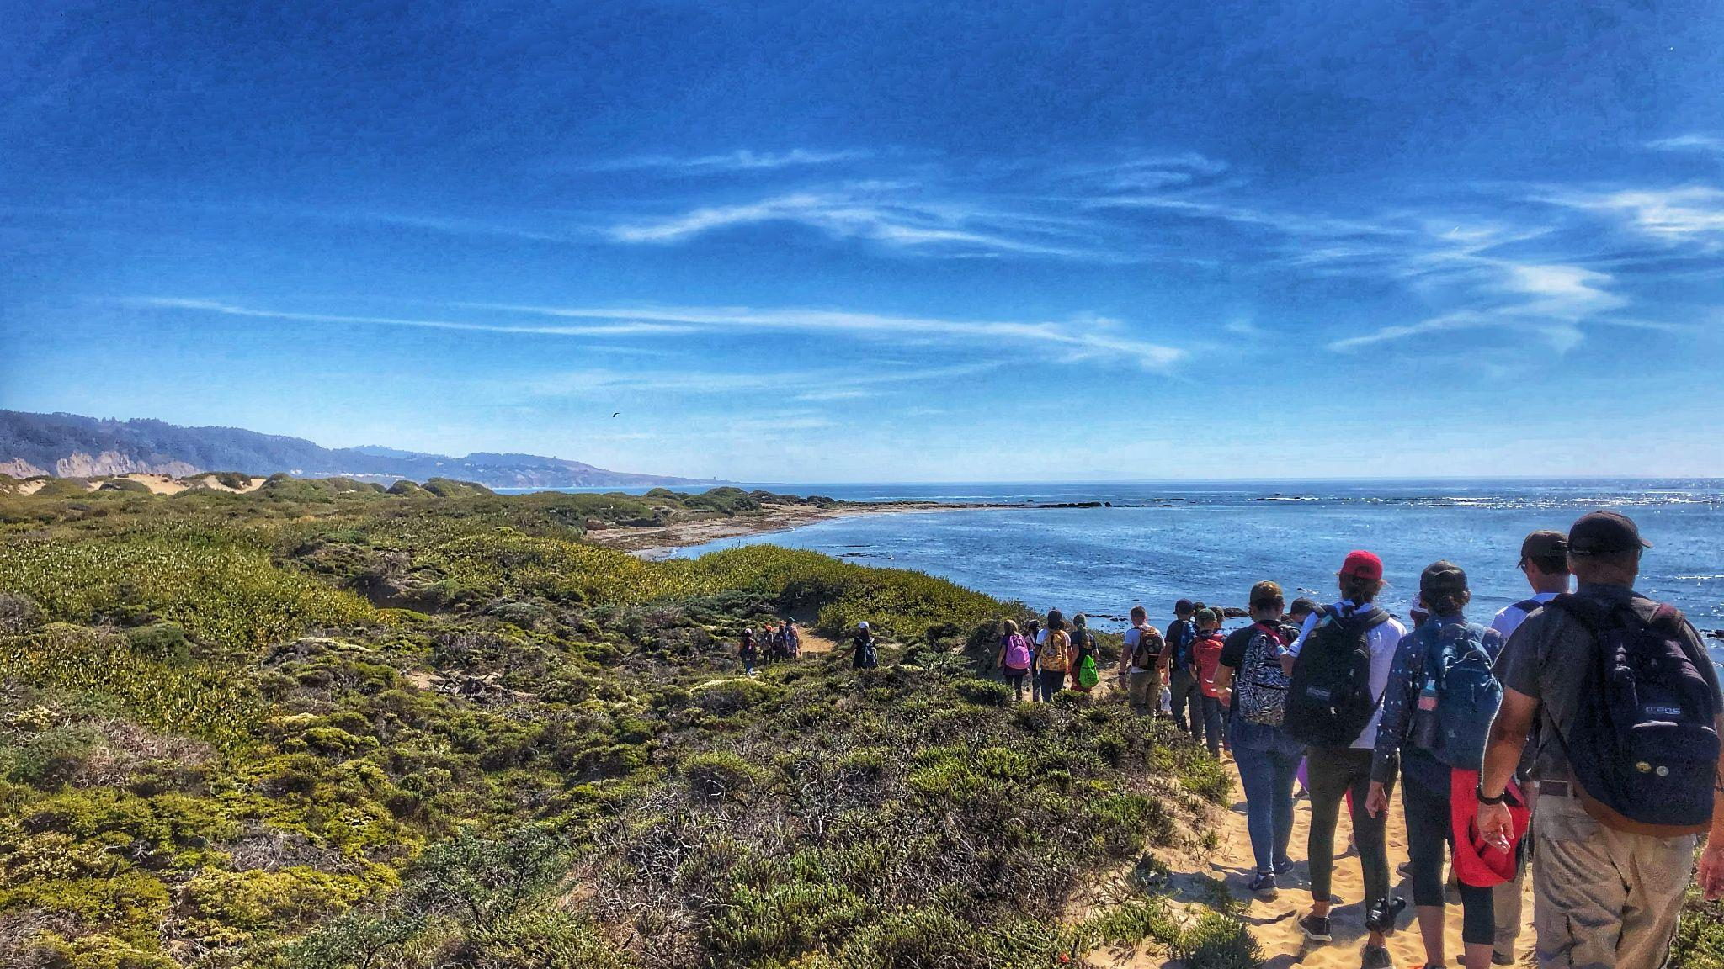
Año Nuevo State Park
Notes:
Another one of our outdoor classrooms is Ano Nuevo State Park. We will hike over 3 miles roundtrip at Ano Nuevo. We spend all day there and pack our lunch. It is a long hike but we make many stops along the way to learn about and hopefully see some of the animals that call Ano Nuevo their home. This includes bobcats, coyotes and hawks, we might even see a San Francisco Garter snake, which is an endangered snake that has a bright turquoise stripe on its belly. We will also get a chance to talk about the indigenous people who still call this land home.

Slide 13
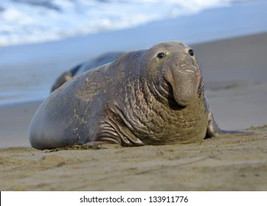
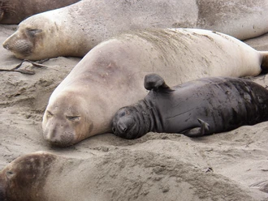
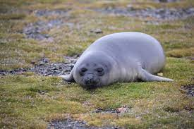
Adult Elephant Seal
Baby elephant seal & mom
Young Elephant Seal
Notes:
And of course, we are going to see elephant seals! They are the real stars of the show at Ano Nuevo State Park. Pictured here is an adult Northern elephant seal, which is one of the biggest seals on the planet, weighing in at 5,000 lbs. You are going to become elephant seal experts during your time at Pigeon Point.
This is a young elephant seal. You will likely see many of these juveniles on your visit. They are curious and cute and very fun to watch.
Here is an adult female and baby elephant seal. Notice that the young elephant seals and females do not have the big proboscis, or nose, like the adult males.

Slide 14
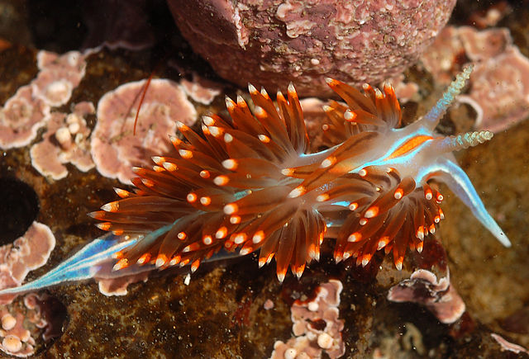
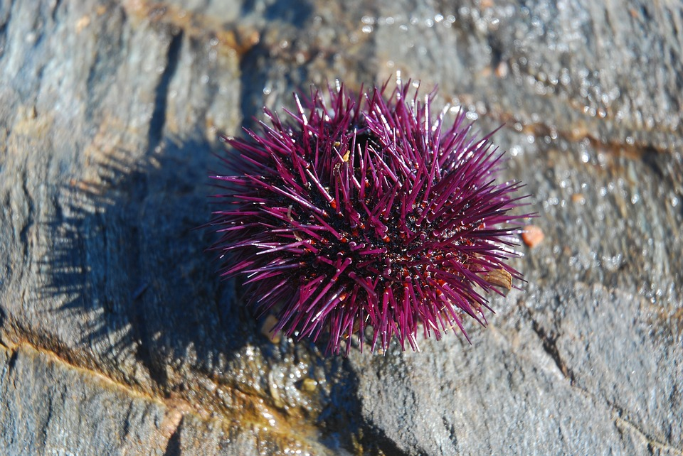
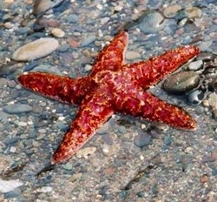
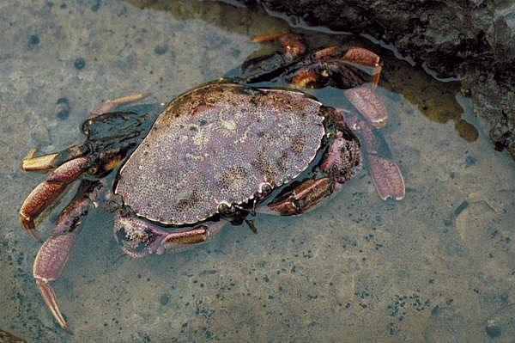
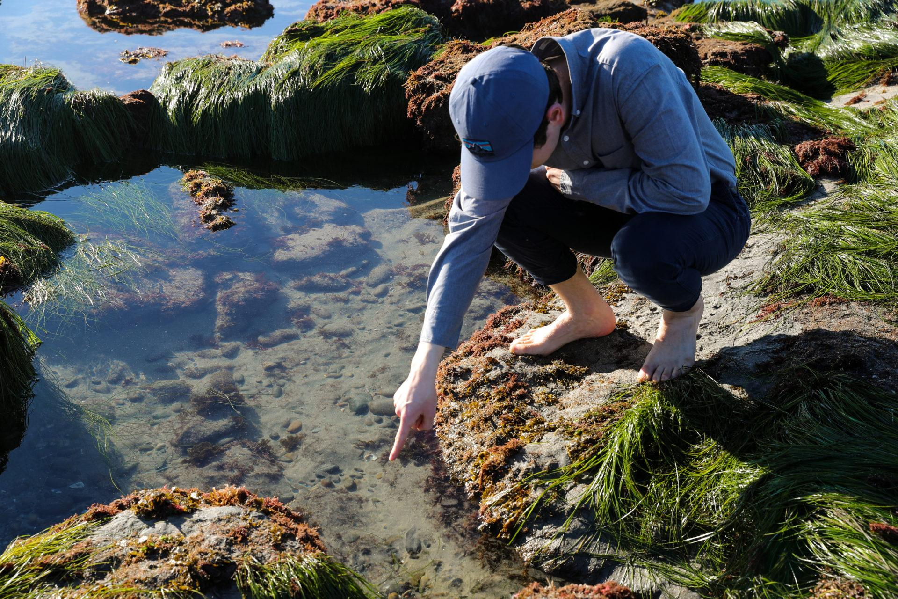
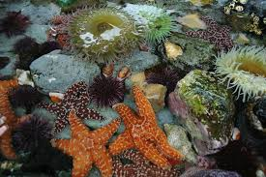
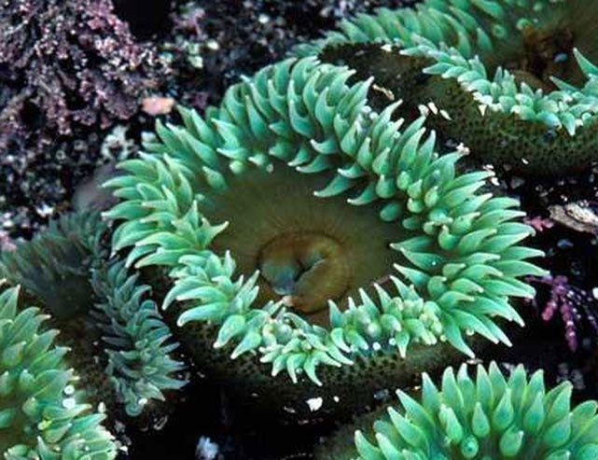
TIDEPOOLS
Notes:
Another interactive outdoor classroom at Pigeon Point are the tidepools. We wait for the best low tide for us to go out and explore the tidepool zone. Before we visit this special place, we will teach you how to identify some of the creatures commonly found in the tidepools and how to safely interact with some of them. We will also give you some tips on how to safely move around the tidepool zone.
And then we go to the tidepools where we are free to explore within the boundaries and share your discoveries with your naturalists and classmates.
Some of the creatures that you are likely to find include anemones, hermit crabs, nudibranchs, and sea stars!
One way that you can make sure that you are prepared is to bring a pair of tidepool shoes. These shoes should be close-toed with good tread so that your feet are protected while you navigate the slippery rocks in the tidepools. Good examples include rain boots, sneakers, or water shoes. We will talk more about the packing list later, but please note that you will want an extra pair of shoes specifically for the tidepools because they might get wet.
Another fun outdoor classroom that we get to check out is the beach! We may play some games, find beach treasures, and have some free play time on one of the beaches located on the Pigeon Point site.

Slide 15
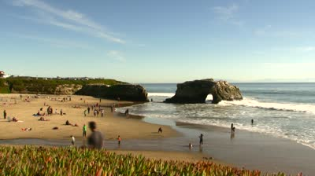
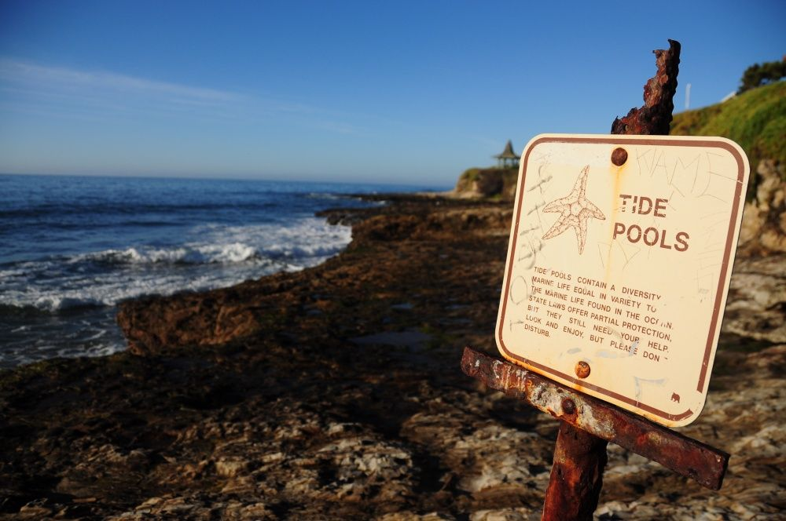
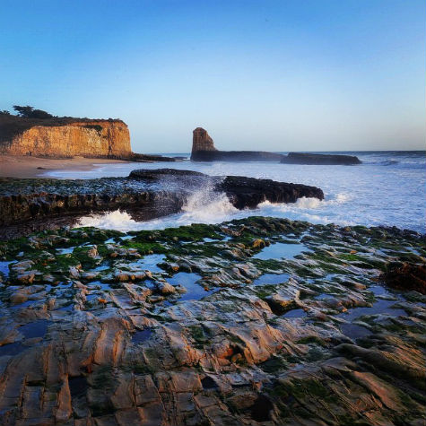
BEACH DAY!
Notes:
Another fun outdoor classroom that we get to enjoy is the beach, which is dependent on the tide! We may play some games, find beach treasures, and have some free play time on one of the beaches located on the Pigeon Point site.

Slide 16
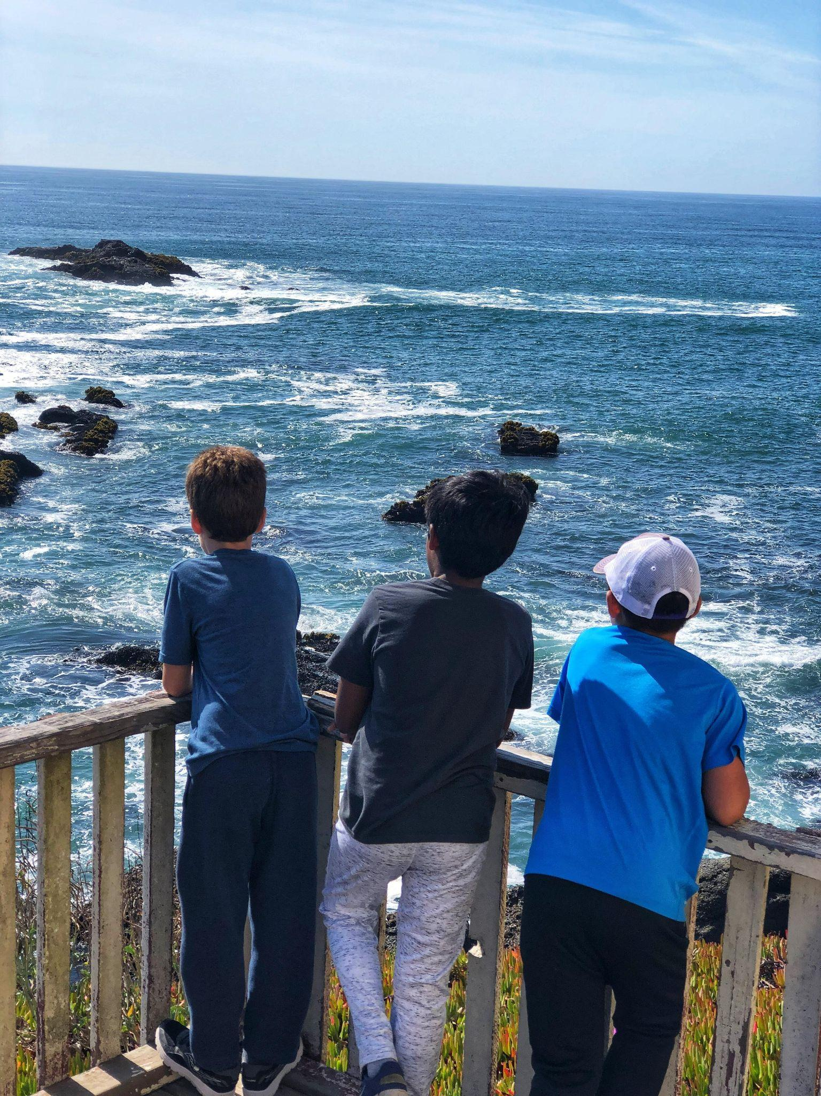
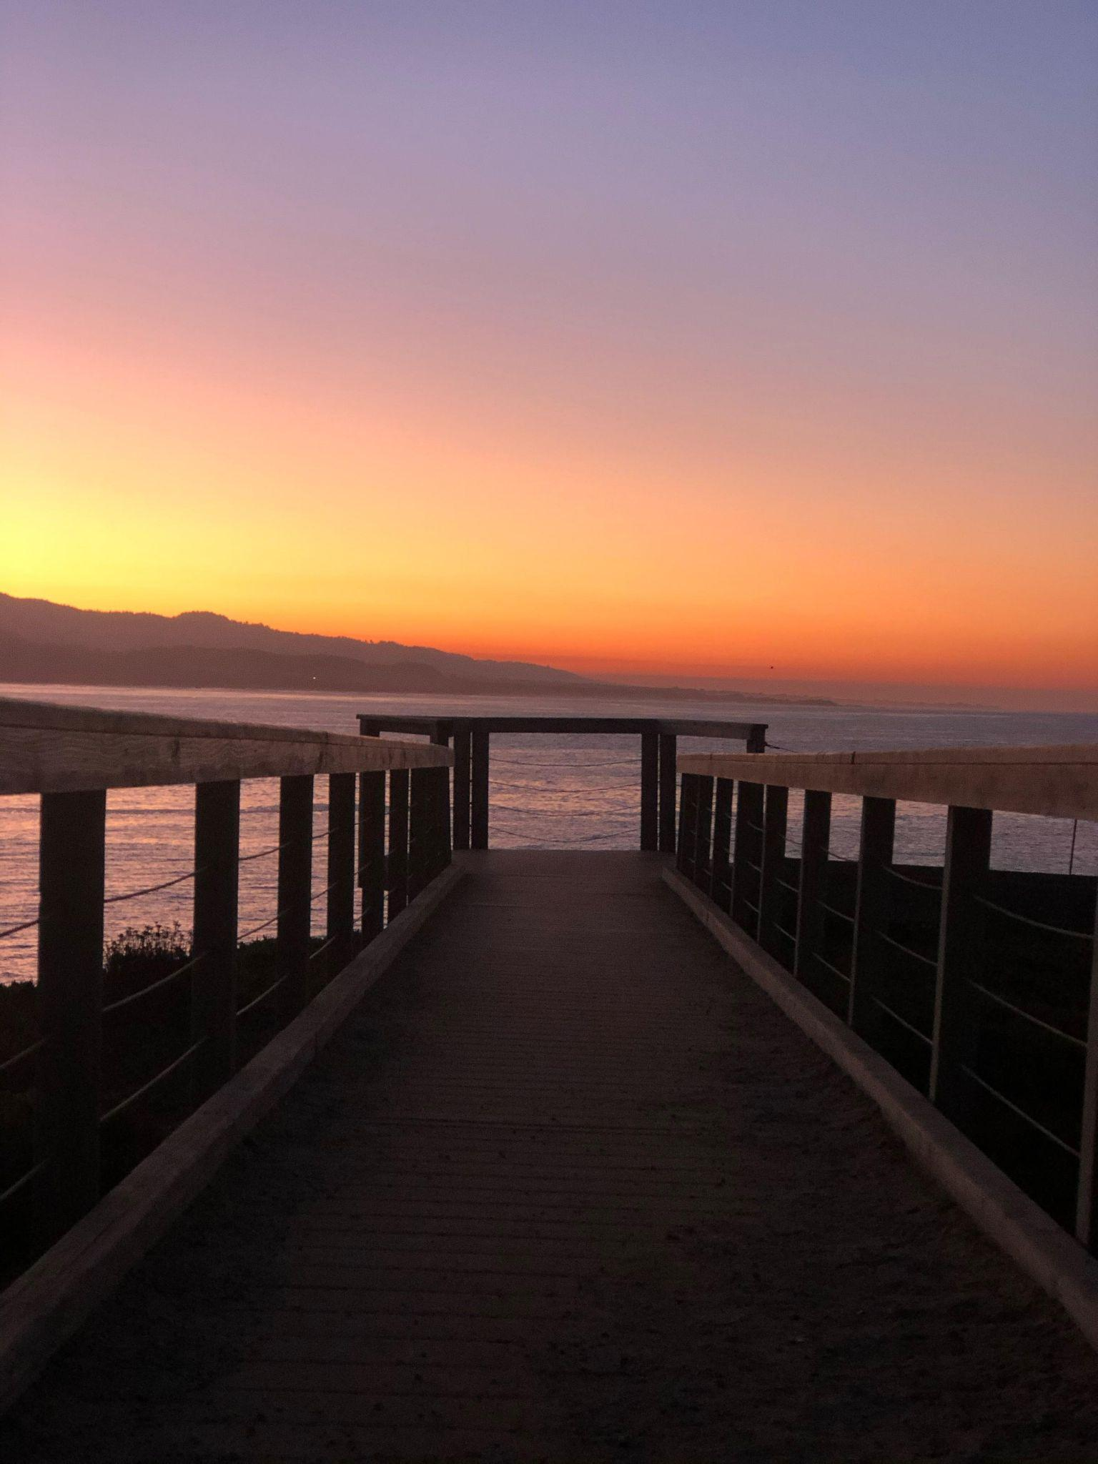
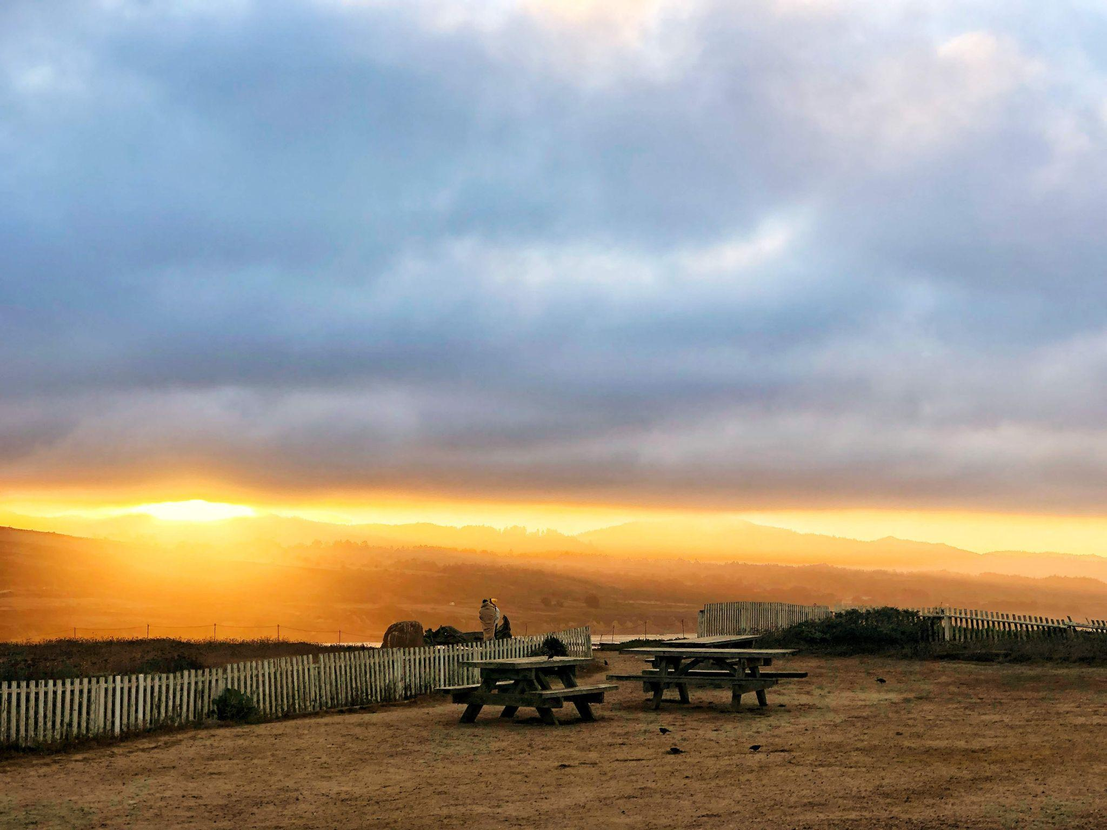
Recreation
Time!
Notes:
And of course, you will have some recreation time at Pigeon Point where you can choose what activity you want to do. Some recreation time activities include playing games in your dorms, watching wildlife with binoculars at the Point, playing sports in the recreation field, or resting and reading a book.

Slide 17
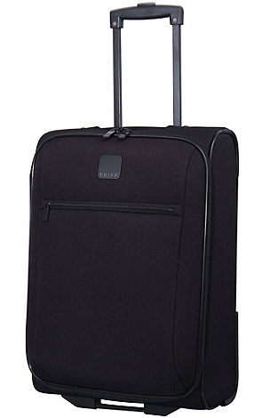
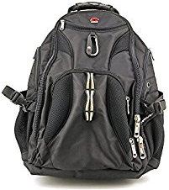
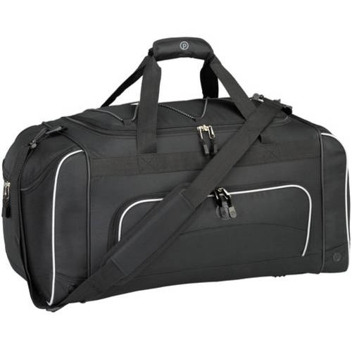
or
To pack your Sleeping Gear
To pack your Clothes
For taking on your
Day Hike
Notes:
Now that you have heard about all of the fun things that you are going to at Pigeon Point, lets talk about how you can get prepared for your trip. You will be getting a packing list from your teacher that details all of the things you should bring to be prepared. You should pack these items in 3 bags. Your clothes and other things can go into a duffel bag or suitcase. Your blanket or sleeping bag should get packed inside a garbage bag to keep it clean. Then, you will need a backpack that you will put all the things that you want on a hike so that you arrive adventure ready!
As mentioned, you will get a packing list of all of the things that you need to bring. You will want clothes for this trip that you can get dirty. We are an outdoor school so we may sit on the ground and sand. The weather on the coast can change rapidly, so you will need warm clothes. Dressing in layers is recommended because you can put them on and take them off as the weather changes throughout the day. We mentioned that you will want some shoes for the tidepools, but also bring a comfortable pair of shoes for your hikes. You may consider bringing another pair of slippers and sandals for wearing around the dorms. You should bring a backpack and water bottle for your hikes. And, you will need to pack a blanket or sleeping bag.

Slide 18
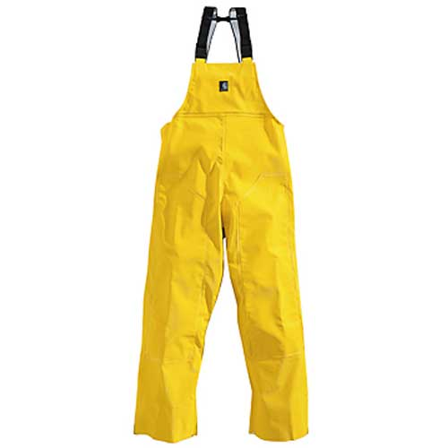
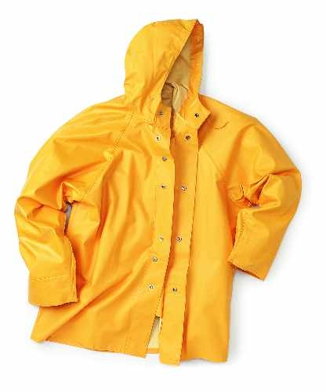
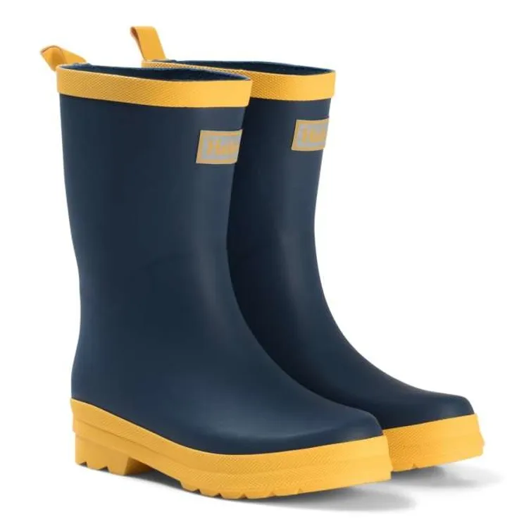
Don’t Forget your Rain Gear!
Notes:
Please do not forget rain gear! This can be a rain coat or poncho, or both. Even if rain is not in the forecast we ask that you come prepared with rain gear that you will keep in your backpack. We will go out on hikes rain or shine, so come prepared so you stay dry and happy!

Slide 19
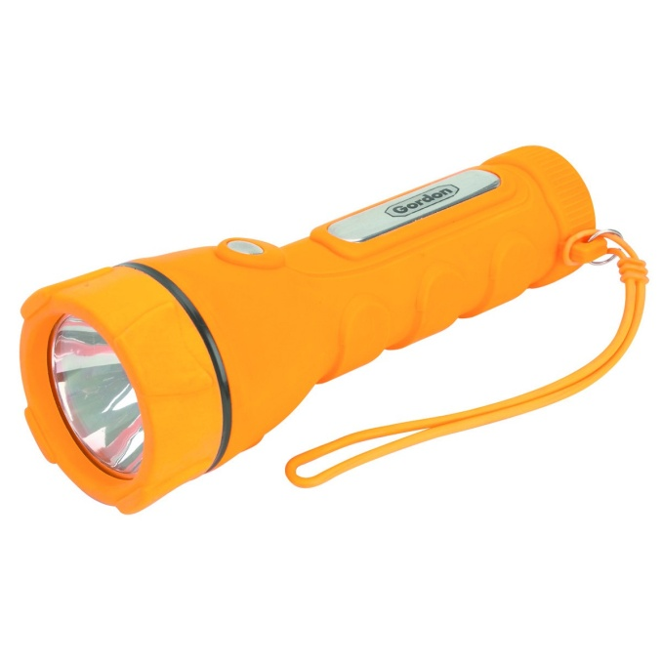
3 Approved Electronics
Camera (disposable recommended)
Flashlight (extra batteries)
Watch
Notes:
One last thing about packing- there are only three approved electronics for outdoor school. One is a camera, your parents can send you with a digital camera but we recommend a disposable camera. Please bring a flashlight or headlamp for night time or in case we lose power. You may also bring a watch, but please no smart watches. Please do not bring cell phones, or ipods or kindles. We do not want you to lose or break it and we believe that it is important for everyone to have a screen free week. You will have such a great time connecting to nature and each other unplugged!

Slide 20
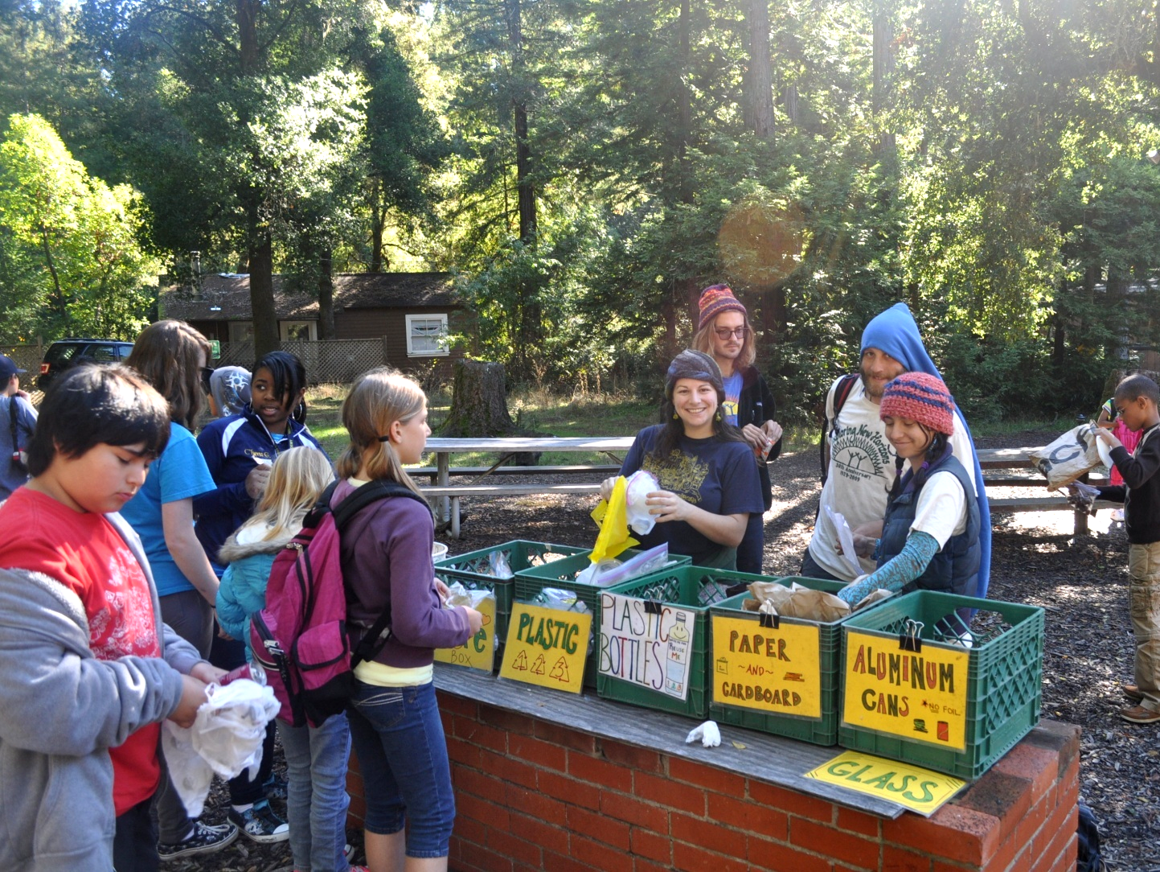
Bring a LUNCH for the first day…
Remember to pack a water bottle!
Notes:
You will want to pack a lunch for the first day that you will eat shortly after you arrive. No food will be allowed in the dorm rooms after lunch. All medicine that you take will need to be checked in with your teacher before the trip and will not be allowed in your suitcase. Your teacher will give you instructions about how to do this. And remember to bring a water bottle!

Slide 21
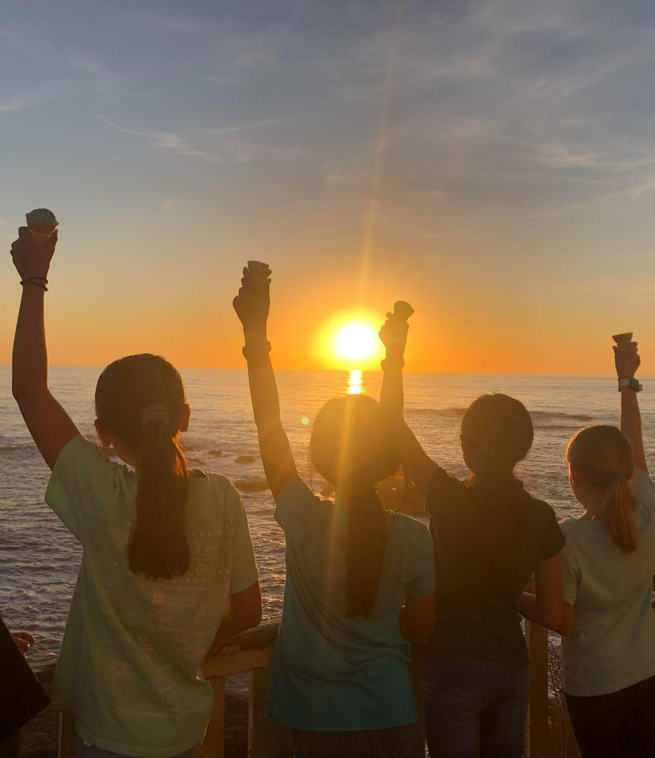
Be sure to pack:
Clothes you can get dirty
Comfortable shoes
Backpack
Layers
Water bottle
Notes:
Again please remember that the clothes you are packing should be clothes that you are ok with them getting dirty. It is OUTDOOR school afterall
The shoes you bring should be shoes you are comfortable walking around in most of the day, and shoes that you are comfortable with potentially getting dirty. The shoes you wear at school are probably just fine. Remember to bring TWO pairs of comfortable shoes because one pair could get wet.
You need a backpack for every day- it will have your warm layers in it because it gets cool by the ocean. You will also need to bring a water bottle. Any sort of water bottle that will seal shut and not leak. You need to drink plenty of water at outdoor school since you will be hiking and active.

Slide 22
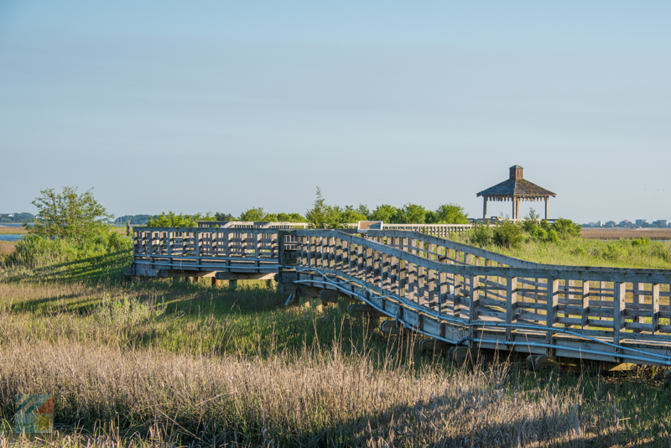
Expectations
BE RESPECTFUL:
Respect ALL living things
(plants, animals, and people!)
No put-downs or roughhousing
Other cabins are OFF LIMITS
BE SAFE:
Stay within boundaries
Please Walk!
Buddy system!!
BE KIND:
Include everyone
Have fun
Notes:
In order to have a great time and stay safe, we ask everyone to follow some basic rules while at Outdoor School. Respect is the number one rule at Pigeon Point. This is for all living things, including plants, animals and people. Put-downs and roughhousing are not tolerated. Your naturalist will be marking your boundaries everywhere that you go, so please follow those directions to keep you safe. And we ask you to walk, not run. Wherever you go, you should be with a buddy. These rules are here so you can have fun!

Slide 23
Inspiring, empowering, and transforming children's
lives through outdoor education.
Notes:
We will see you at the lighthouse! The Exploring New Horizons at Pigeon Point naturalists look forward to sharing a really awesome time with your class.

